Slide 1
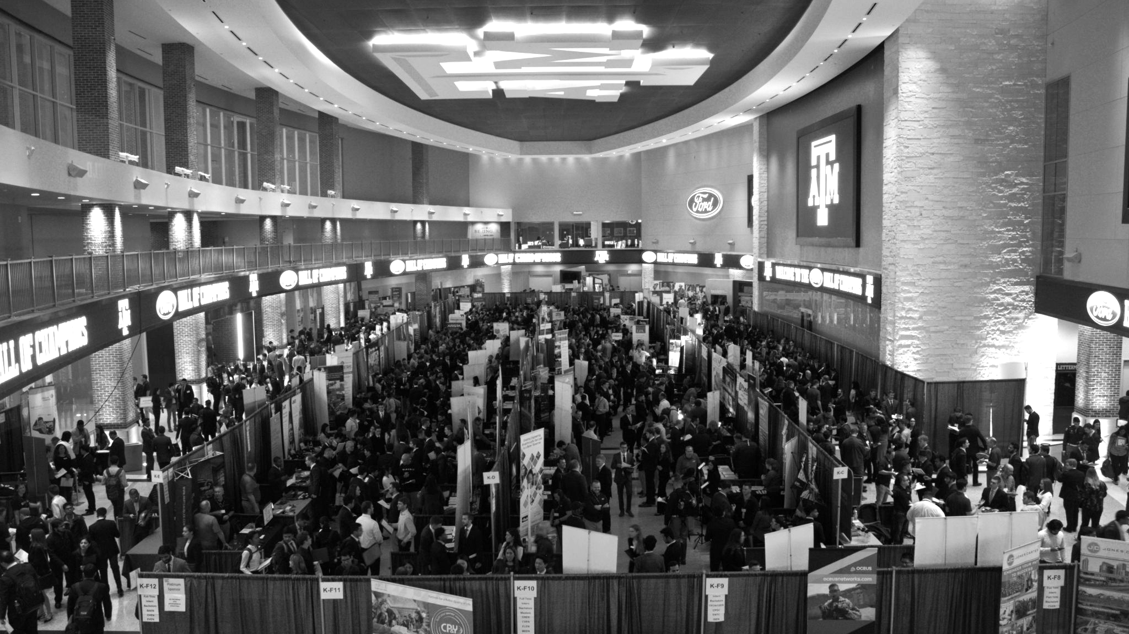

LANL Team Update
11/13/2024
Izzy Baumler, Dalton Boeckmann, Morgan Gullo, Jade Waldron

Slide 2
Mission Statement
There is a need for a technology that has 6 DOF and can move through its full range of motion in each degree of freedom of at least 1 Hz.

Slide 3
Weekly Updates
All members have finished Red Badge Training and have received their badge
Began Yellow Badge Training for 3D-printer access
Still waiting on response for MEEN 402 reserved space in FEDC
Continued working on Embodiment Design and Validation Plan

Slide 4
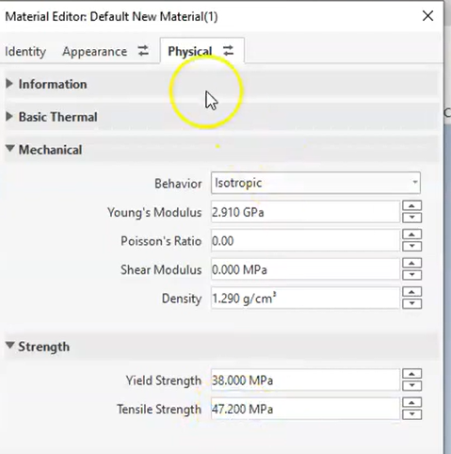
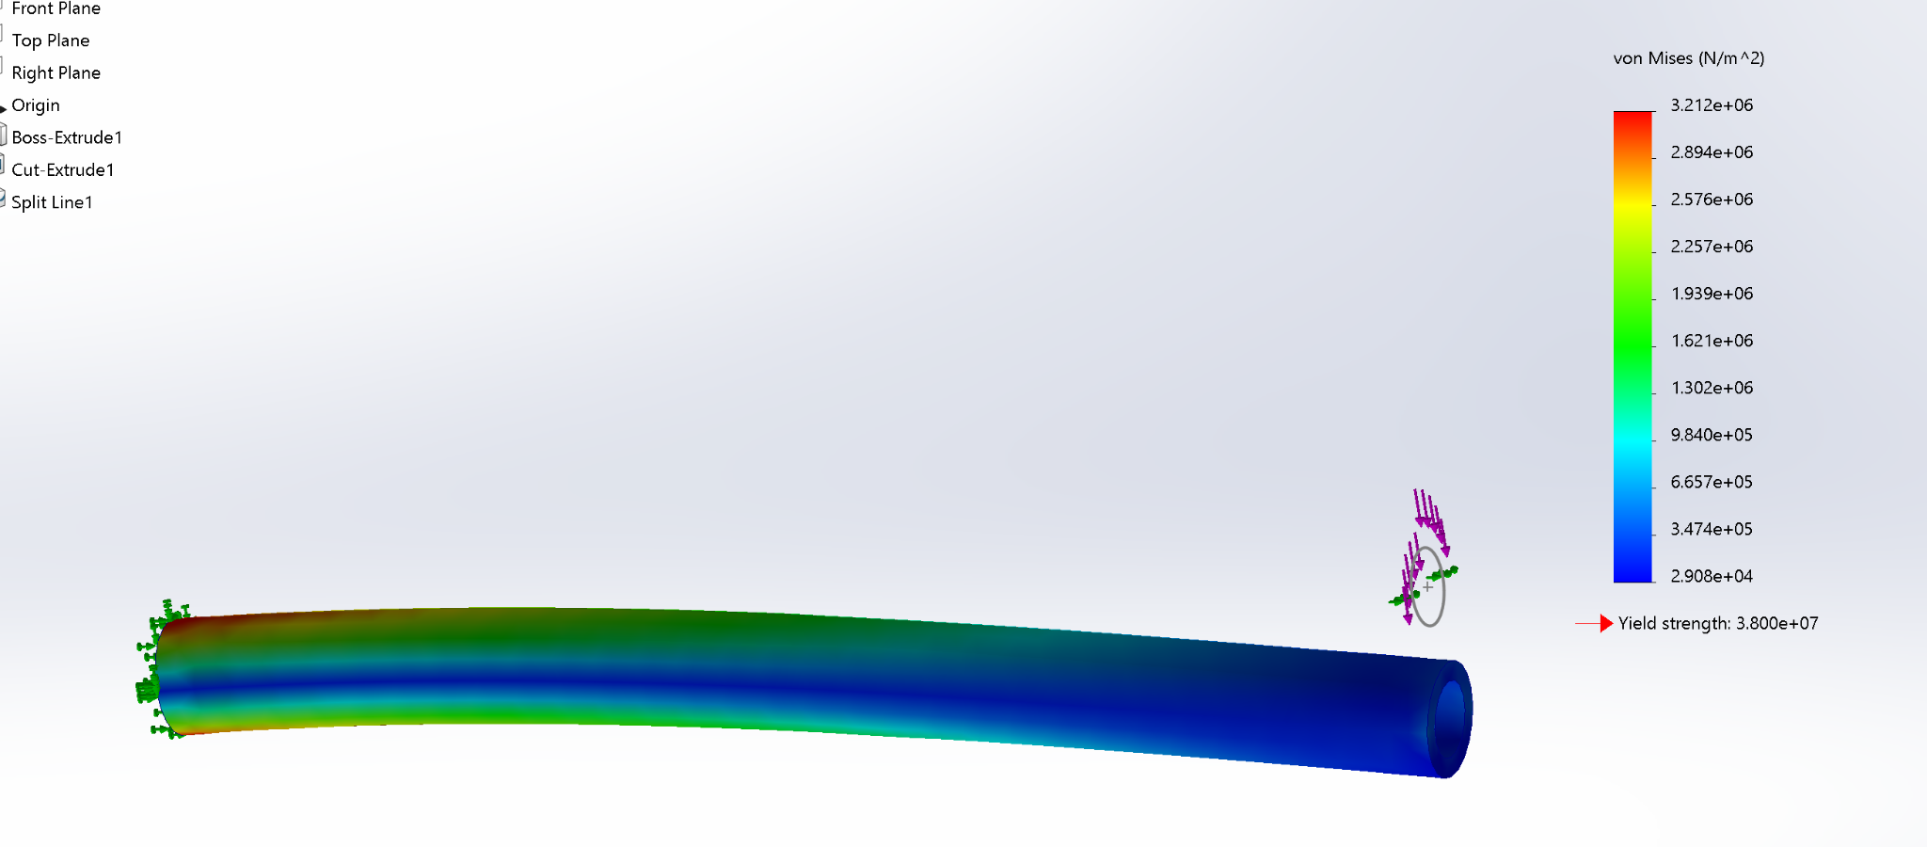
Validation Plan
FEA simulation shows:
von Mises, displacement, and strain
Von Mises

Slide 5
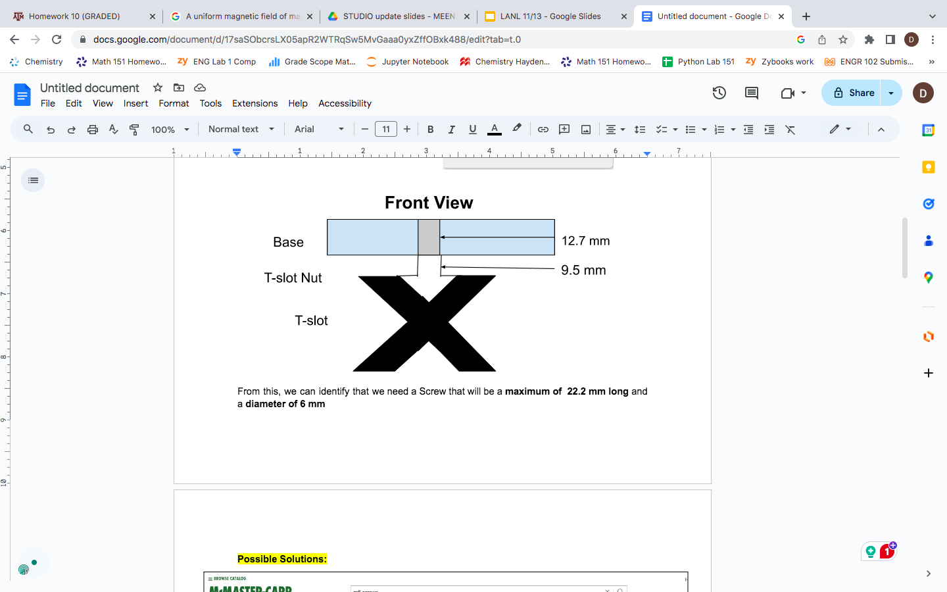
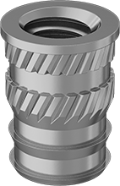
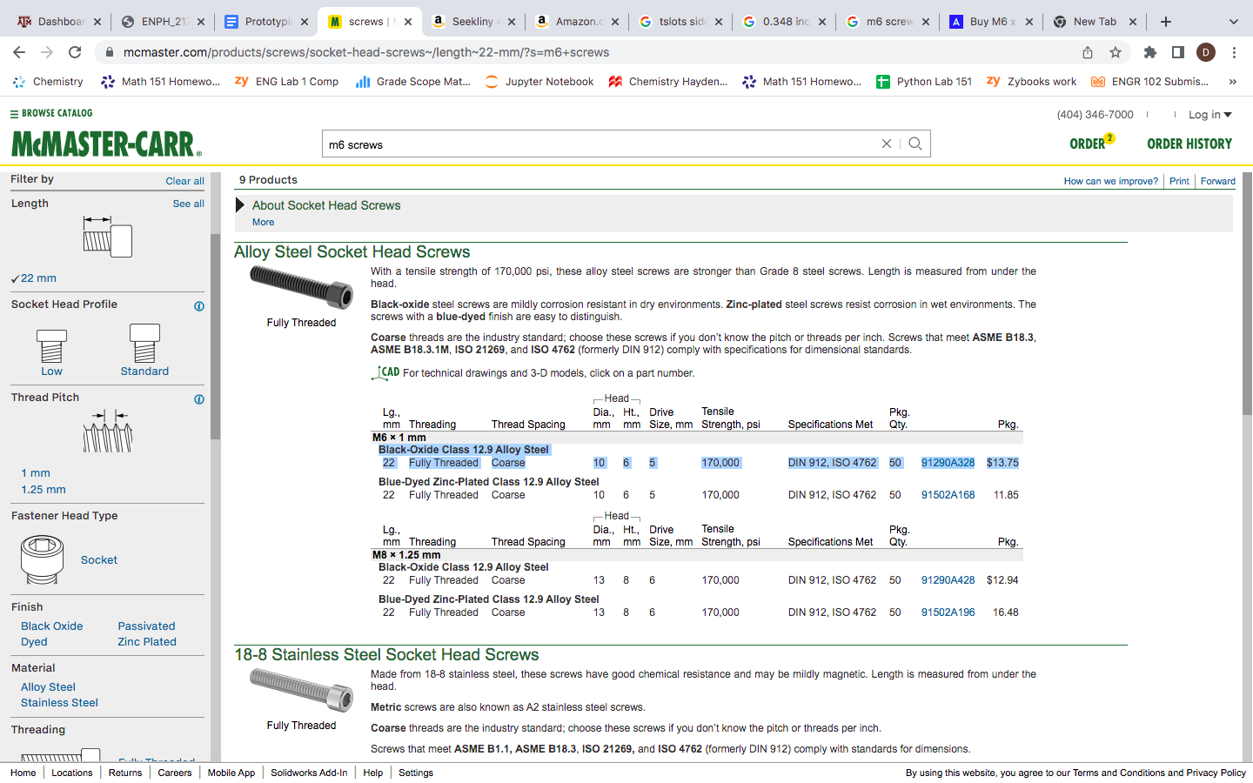
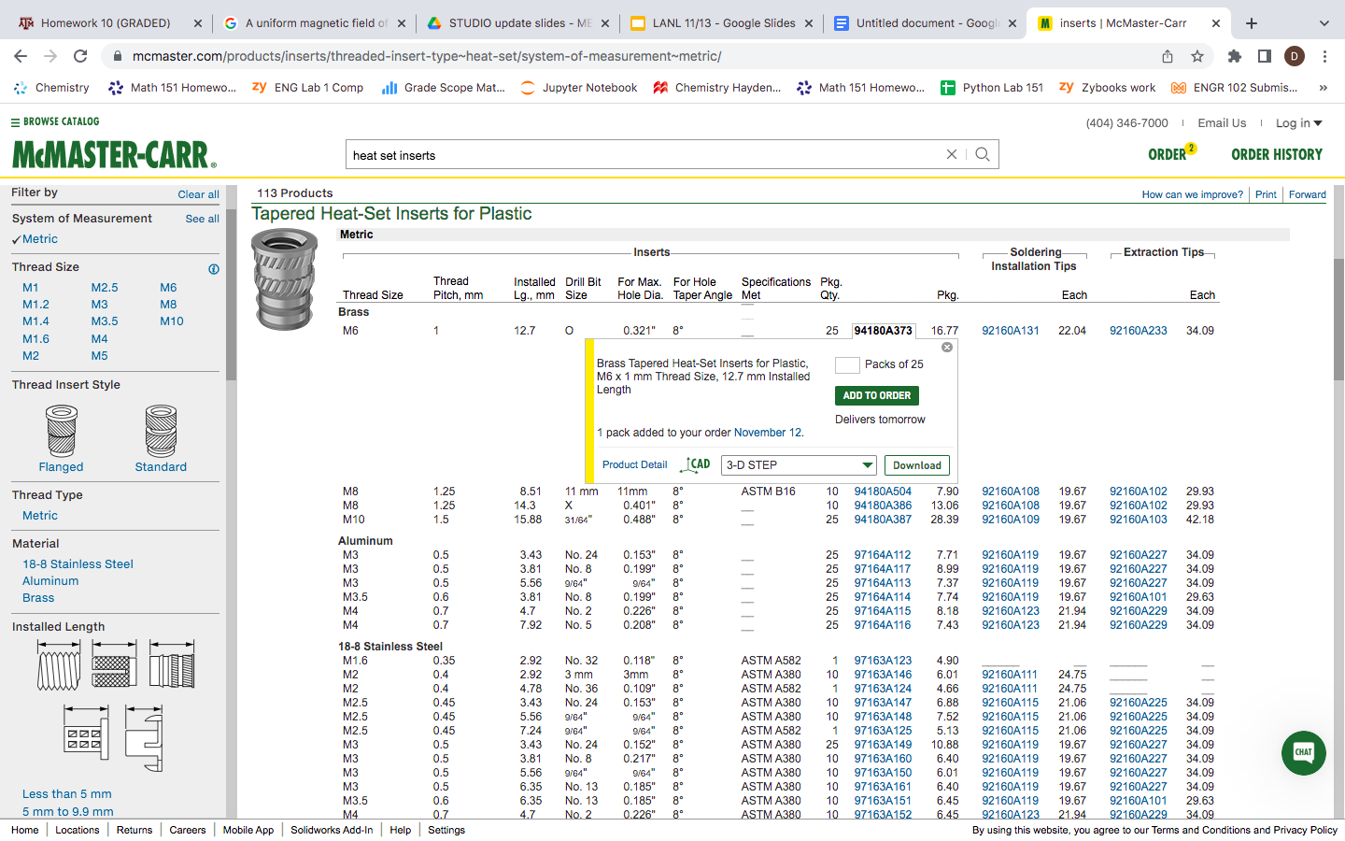
Fasteners
Heat Set Inserts - Soldered
Screw Selection Process (M4, M6), vary in lengths
Fastener Analysis
T-Slot 40mmx40mm
Specified Base and Motor 1 Fasteners, working bottom up to account for all components
Notes:
Dalton:
Why we need Heat Set Inserts
Need to be Soldered
Why the screws need to be specific lengths
WHy we need M6 and M4 (compatibility with Different motors and Base)
Fastener analysis huge factor of our design
Talk about Tslot nuts
Why we had to increase to 40x40 Extrusions
You can help explain in the drawings with morgan and Izzy how we plan on securing certain fasteners to motors/3D printed parts

Slide 6
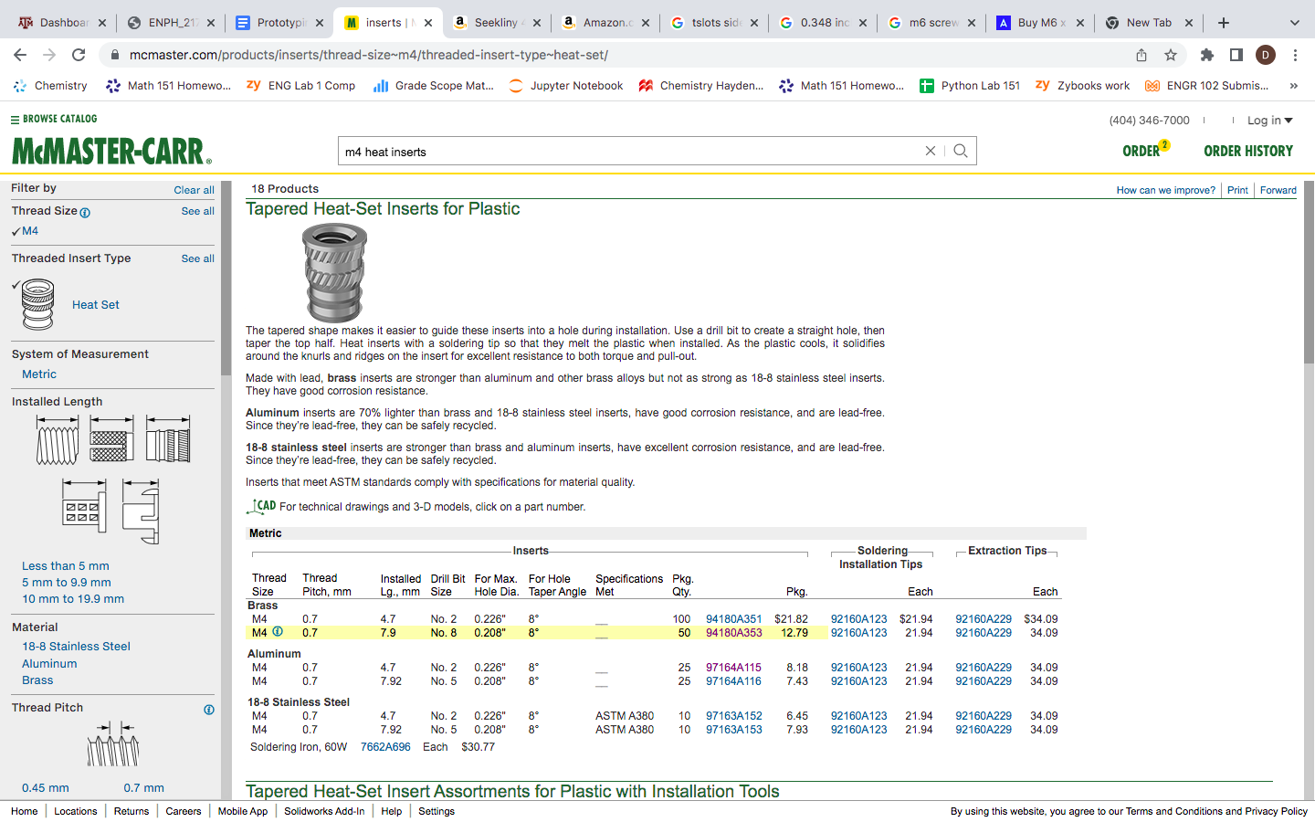
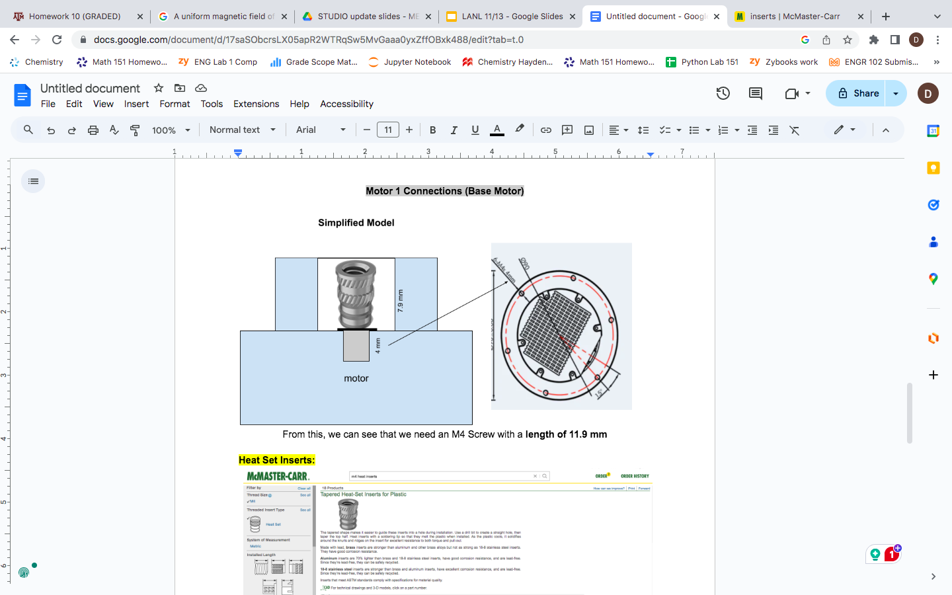
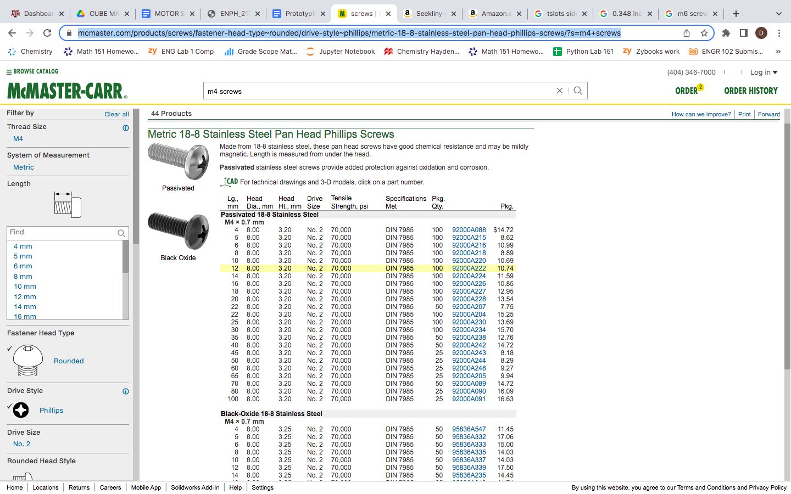
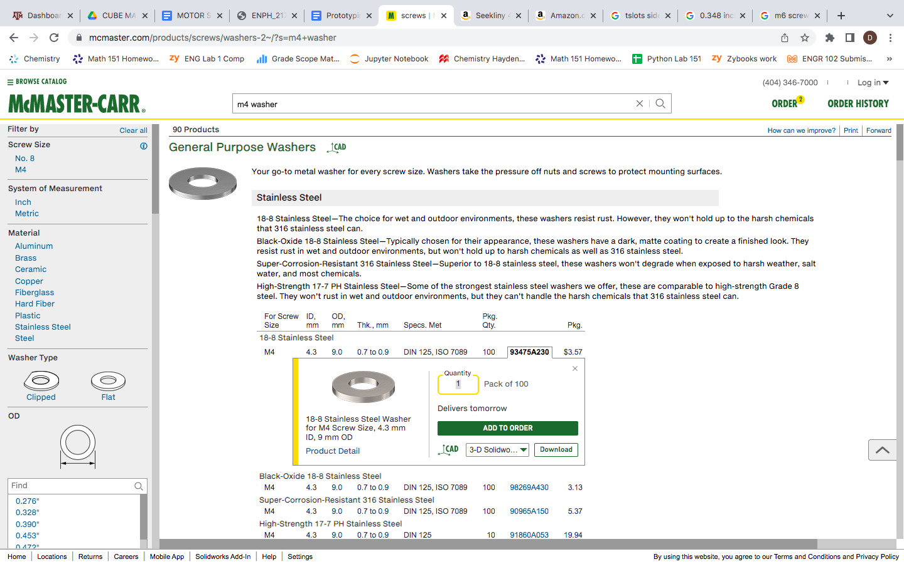
Fasteners
Motor 1 Connection
Notes:
Dalton:
Why we need Heat Set Inserts
Need to be Soldered
Why the screws need to be specific lengths
WHy we need M6 and M4 (compatibility with Different motors and Base)
Fastener analysis huge factor of our design
Talk about Tslot nuts
Why we had to increase to 40x40 Extrusions
You can help explain in the drawings with morgan and Izzy how we plan on securing certain fasteners to motors/3D printed parts

Slide 7
Inverse Kinematics
Talked to Robotics experts and they explained how Inverse Kinematics is possible in SolidWorks
“Transform Tab”- “Interactive IK Mode”
Allows you to directly manipulate an end effector to a desired position
The software will output the necessary joint angles to achieve desired position (Inverse Kinematics)

Slide 8
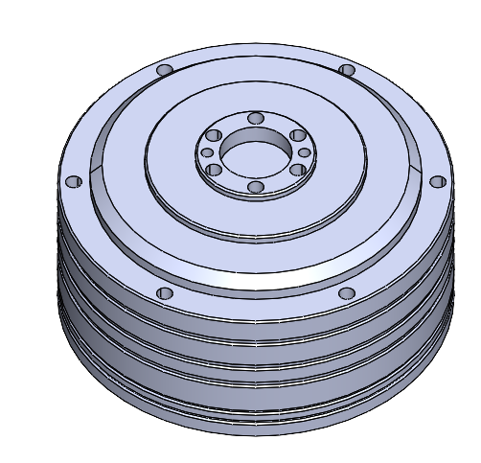
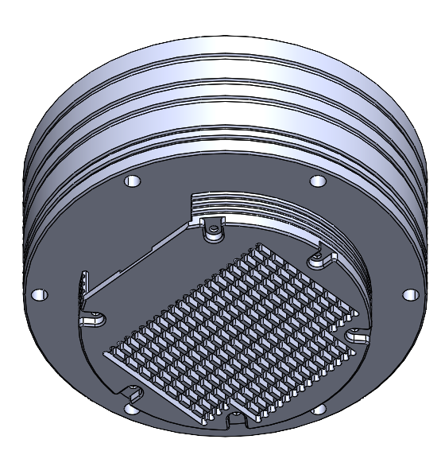
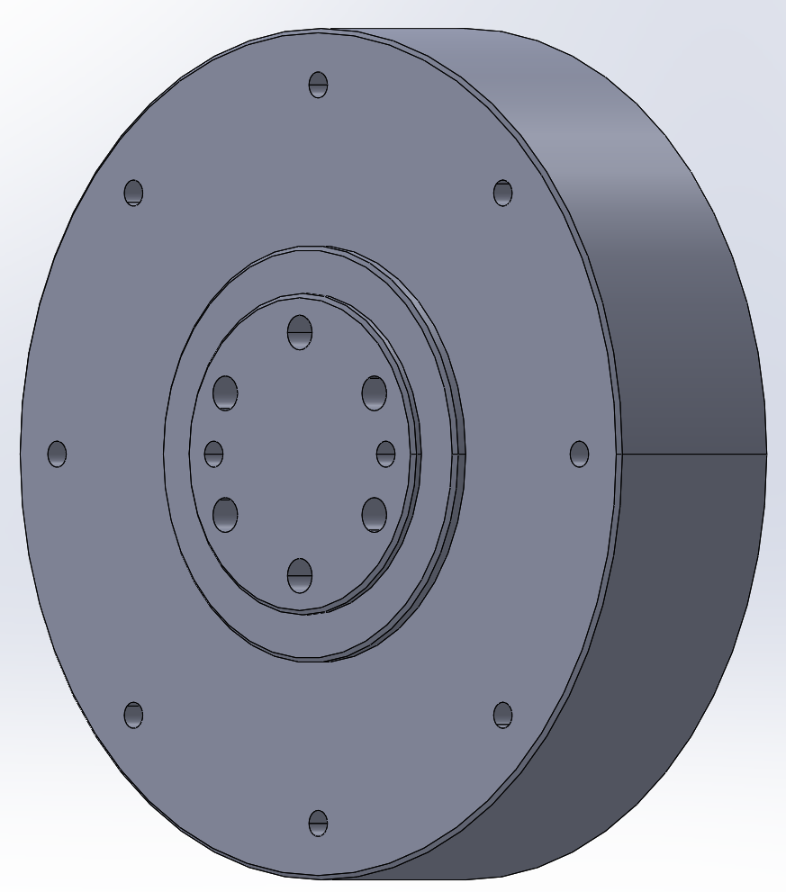
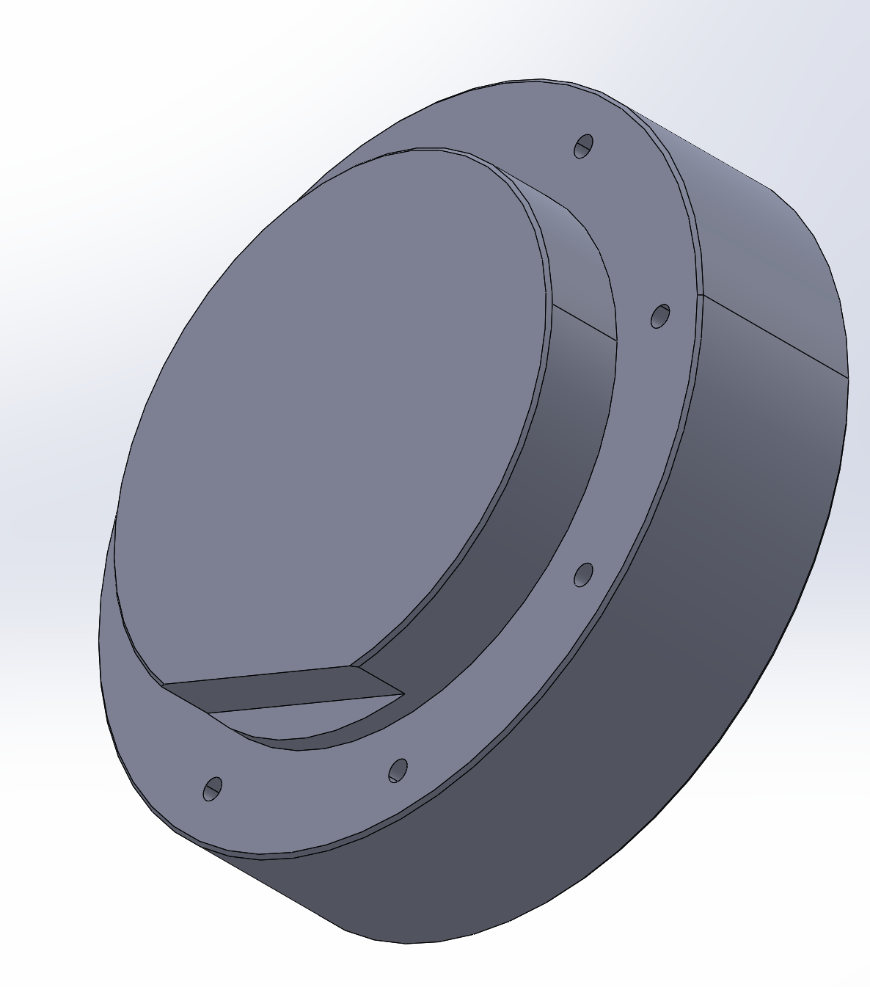
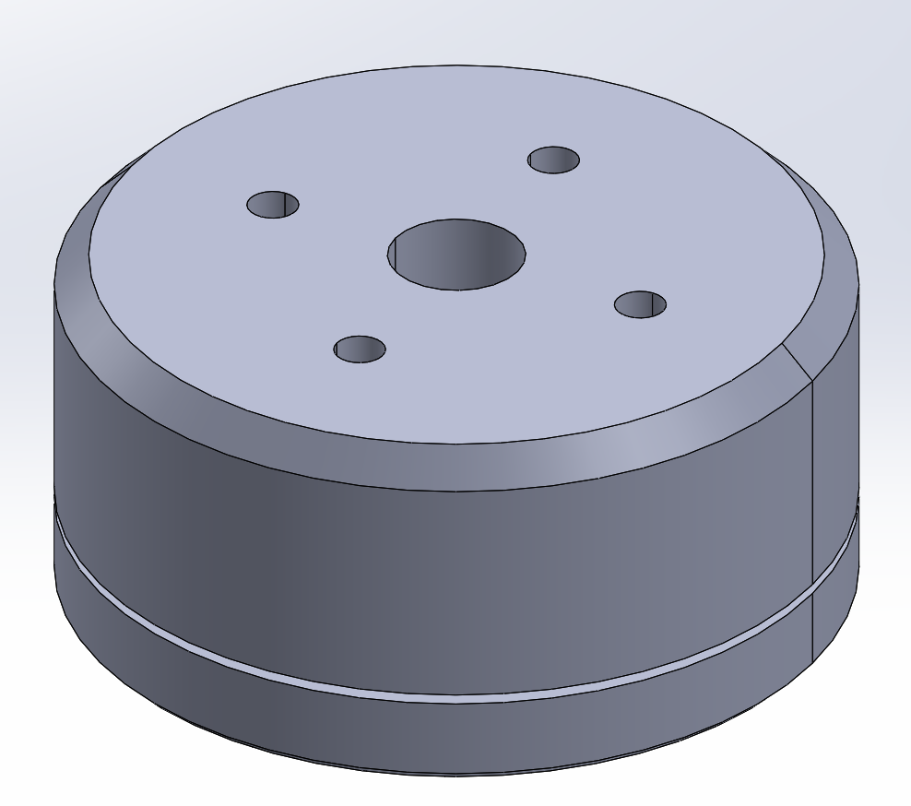
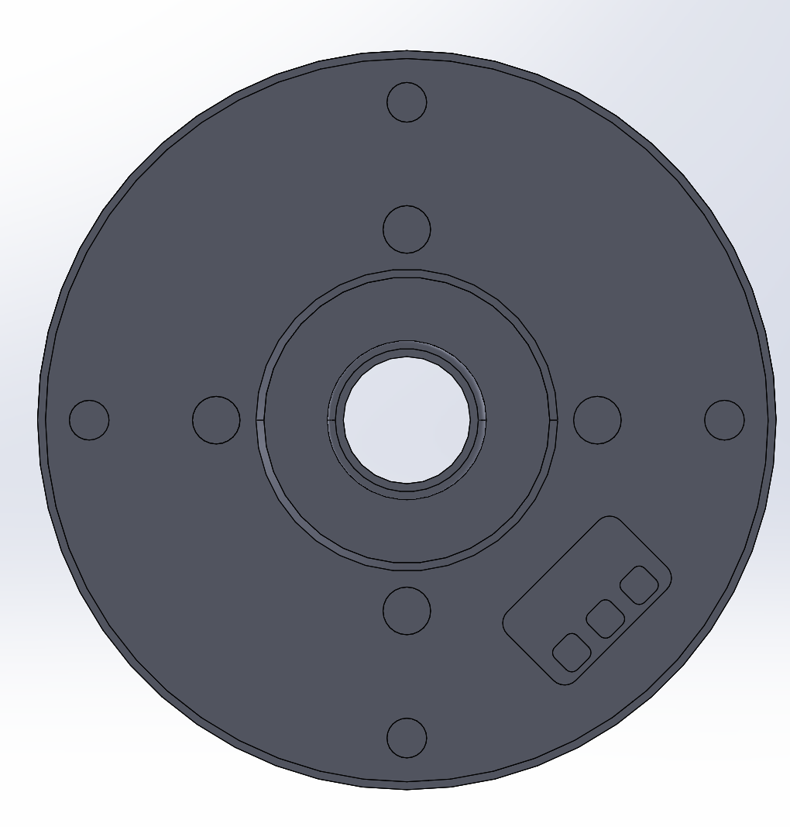
Detailed CAD - Joint Motor(s)
Reached out to CubeMars and asked for detailed CAD models of motors
Started incorporating models into Assembly

Slide 9
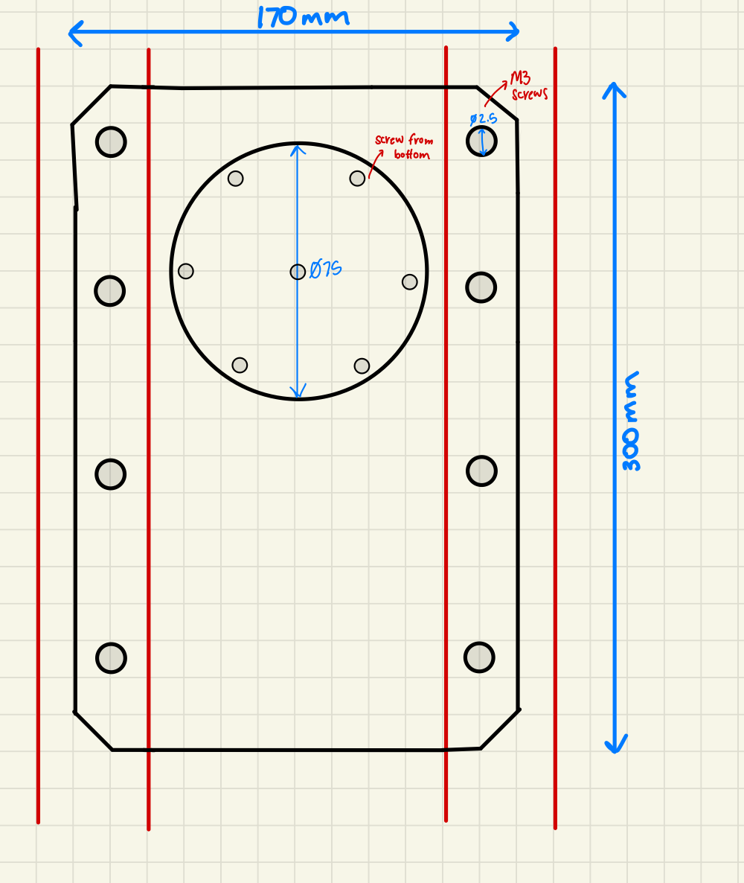
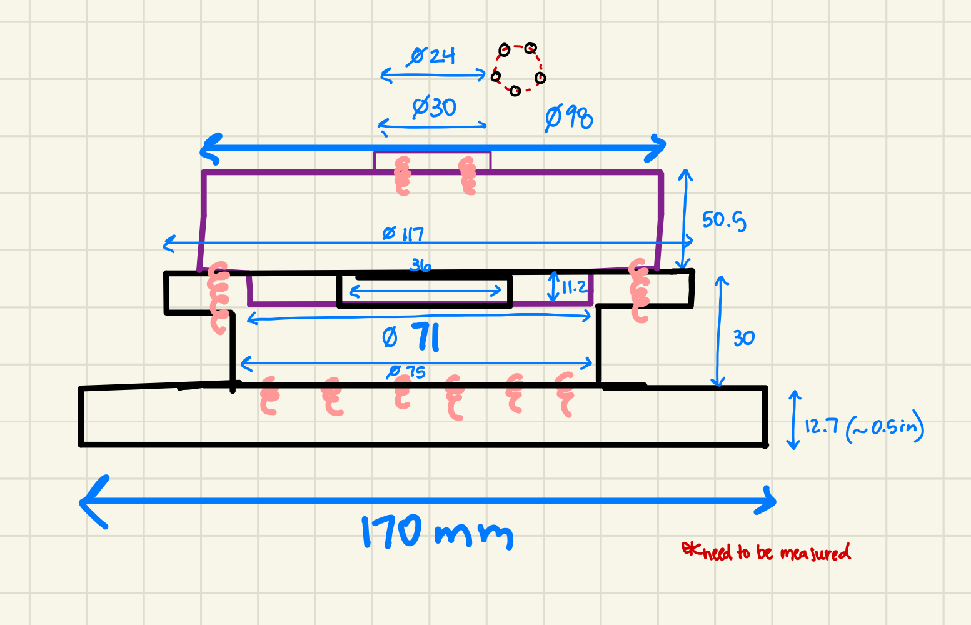
Detailed Drawings

Slide 10
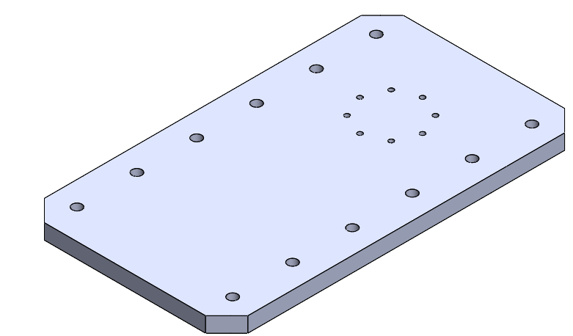
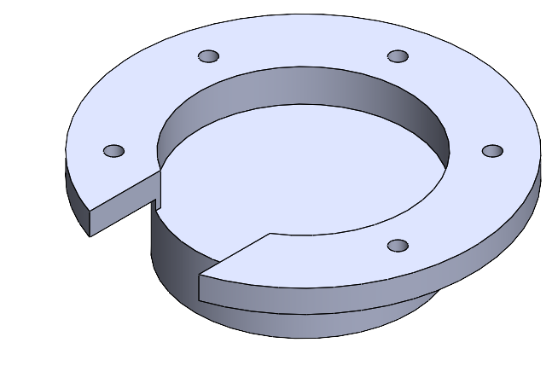
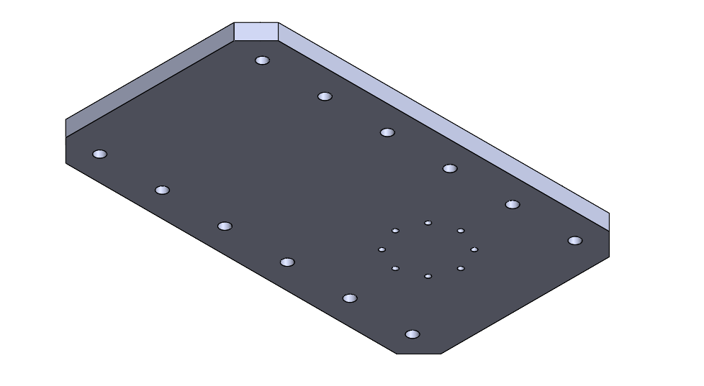
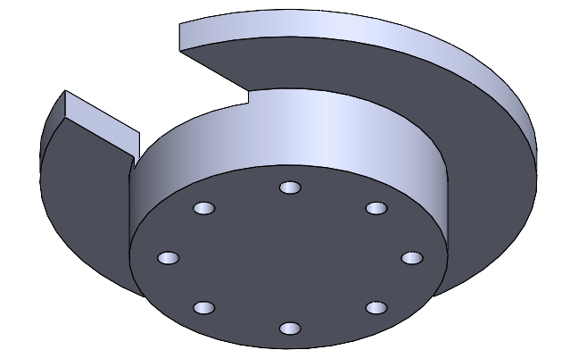
Detailed CAD - Base

Slide 11
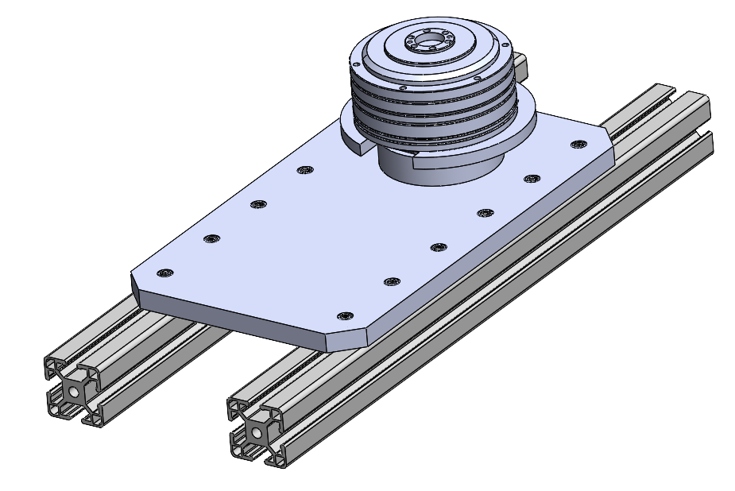
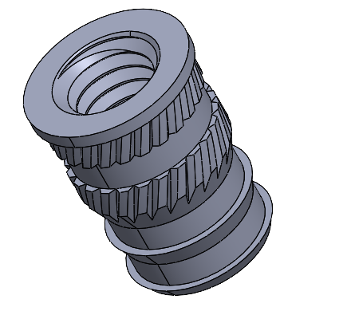
Detailed CAD - Base
M6 Heat Set Insert

Slide 12
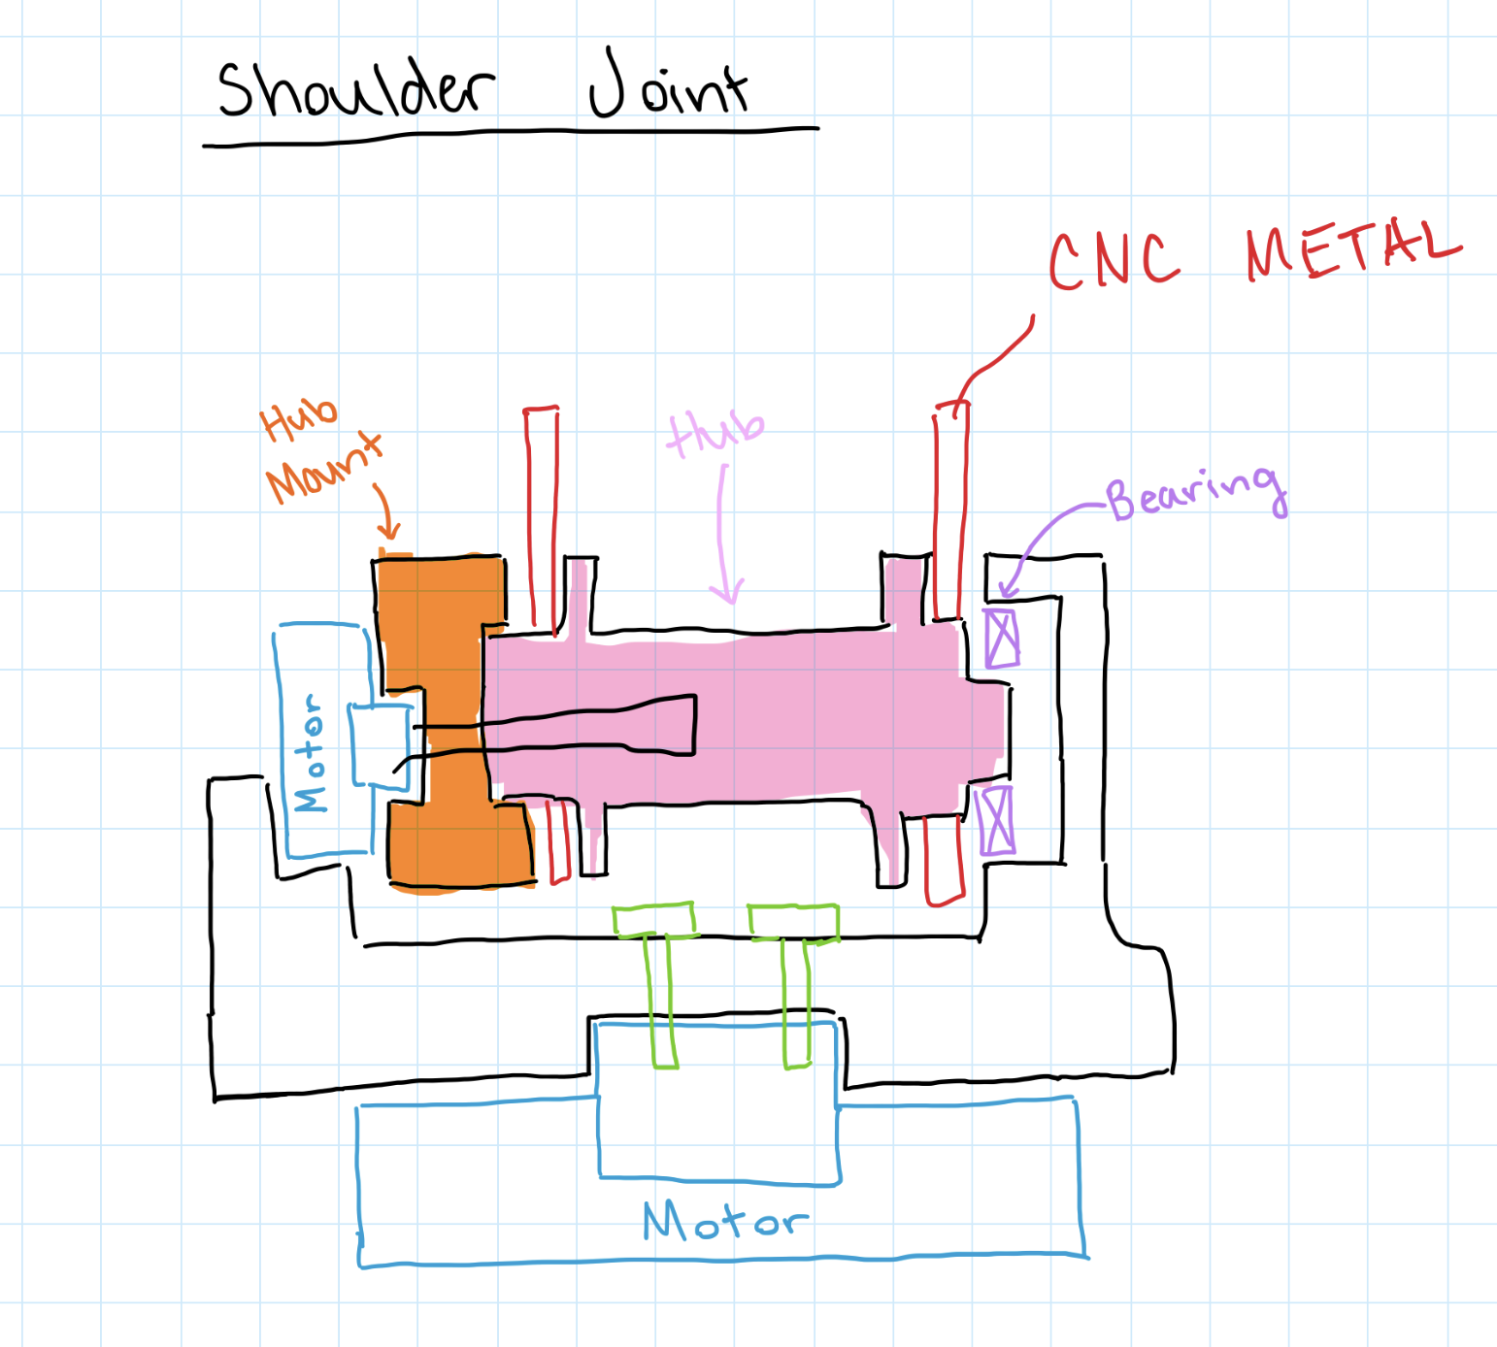
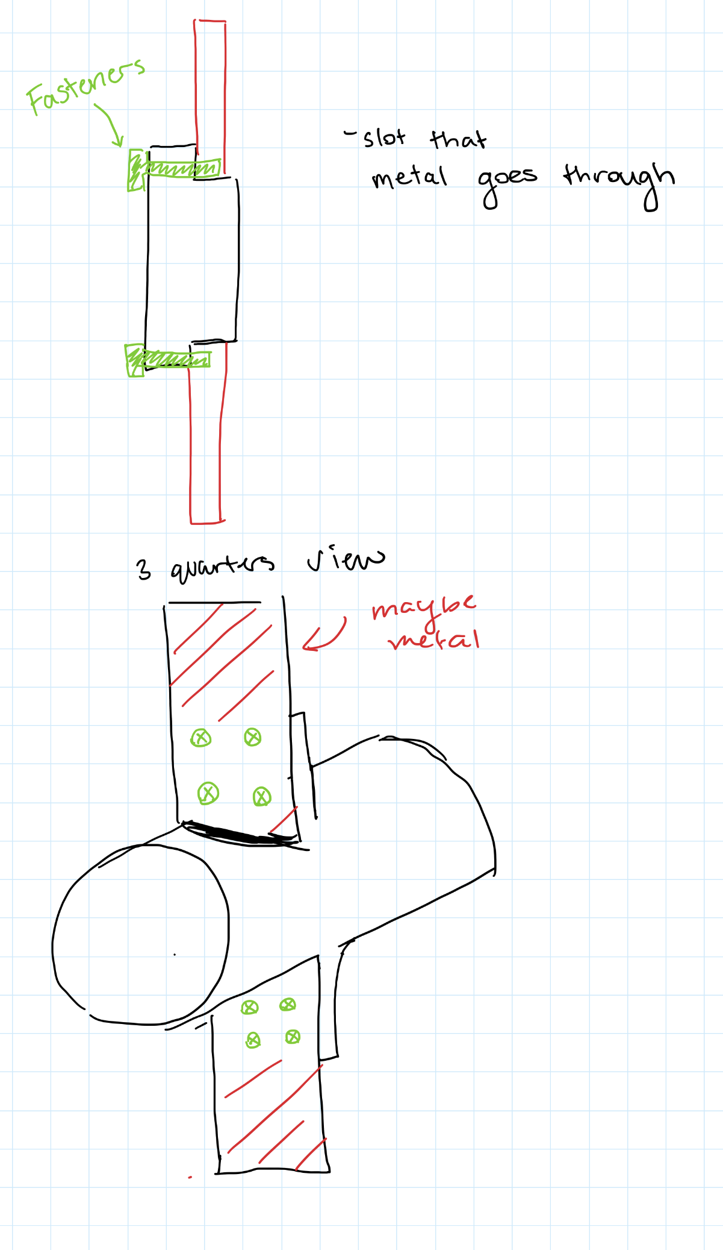
Detailed Drawings

Slide 13
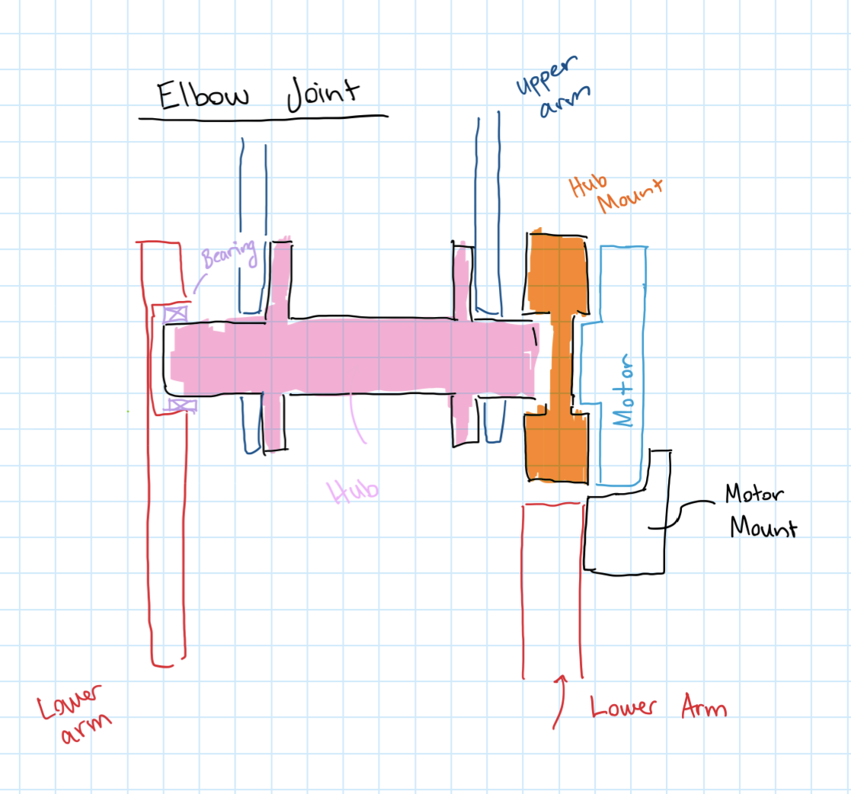
Detailed Drawings

Slide 14
Upcoming Week
Meeting with David on Friday at 10:00 AM
Meeting with Robotics Expert after studio to go over other detailed drawings
Continue working on detailed CAD Model
Receive Yellow Badge Access
Begin ordering materials for arm
Schedule room for final presentation
Continue working on DR3 materials
Update BOM to reflect fastener changes

